Slide 1
Large Language Models

Slide 2
Really good at guessing the next word
How are
you?
Notes:
Let’s make an experiment of how good YOU are at guessing what I mean.

Slide 3
Really good at guessing the next word
I will travel there by train. How are
you getting there?
Notes:
Let's see how your guess change with more context

Slide 4
Really good at guessing the next word
Let go to the
museum
mall
beach
Notes:
Context really matters to make a guess more accurate

Slide 5
Really good at guessing the next word
It’s sunny and warm. Let’s go to the
beach

Slide 6
Really good at guessing the next word
I’m so tired. I need to
sleep

Slide 7
Really good at guessing the next word
Ugh, 6 AM, just woke up. I’m so tired.
I need to
have some coffee

Slide 8
How do LLMs work?

Slide 9
Learning from a Massive Bookshelf
Notes:
Read every book
Not only every book, but also ever magazine, newspaper, website, research paper
Remember every word
Not only every word, but how every word form sentences, and how every sentence form paragraphs
This is the start of the training phase

Slide 10
Recognizing Patterns
Notes:
Recognizes patterns
“Bark” associated with dogs in a text about dogs, but also that dogs is a domestic pet
Might be related to trees in a text about forests
Builds understanding about both language and the world
This help predict the words or phrases that comes next

Slide 11
Generating Responses
Notes:
Remembers how questions usually are answered based of what it has seen before

Slide 12
Fine-Tuning
Notes:
Additional training, often together with humans, to improve understanding and accuracy
Adds guardrails and safety
But also adds risk of bias from the people doing the fine-tuning
Big part of what makes a model better or worse than an equally large model

Slide 13
Interacting in Real-Time
Notes:
Now, when you use ChatGPT, you're interacting with the LLM in real-time. It's using all the patterns it's learned to understand your question and craft a response on the spot. It's like having a conversation with that incredibly well-read friend who can draw on a vast reservoir of knowledge to discuss almost any topic.
In simple terms, LLMs work by learning from a vast amount of text, recognizing patterns in how language is used, and then using those patterns to generate responses to your questions or prompts. It's a complex process made to look easy, like having a chat with a friend who knows a lot about almost everything.

Slide 14
Prompting
Notes:
Be Clear and Specific: State your task or request clearly to avoid ambiguity.
Provide Context: Briefly explain the background or context of your request to help the model understand the purpose and scope.
Use Simple Language: Keep your language straightforward and avoid jargon or overly complex terms that might confuse the model.
Include Examples (if applicable): If your task involves generating content or completing a specific task, provide examples or guidelines to help the model understand what you're looking for.
Specify Length (if necessary): If you have a specific length requirement for the response, mention it in the prompt to guide the model in generating an appropriate response.
Consider Constraints: If there are any constraints or requirements that the model needs to adhere to (e.g., tone, style, topic), clearly outline them in the prompt.
Ask Open-ended Questions: If you're seeking creative or diverse responses, ask open-ended questions that encourage the model to explore different possibilities.
Provide Feedback (optional): If you have specific preferences or expectations for the response, consider providing feedback on previous iterations to help the model improve its understanding and performance.
Be Patient: Understand that LLMs may require multiple iterations or refinements to generate the desired output, so be patient and willing to provide guidance as needed.
Revise and Iterate: If the initial response is not satisfactory, consider revising and refining your prompt based on the model's output to improve the quality of the response.

Slide 15
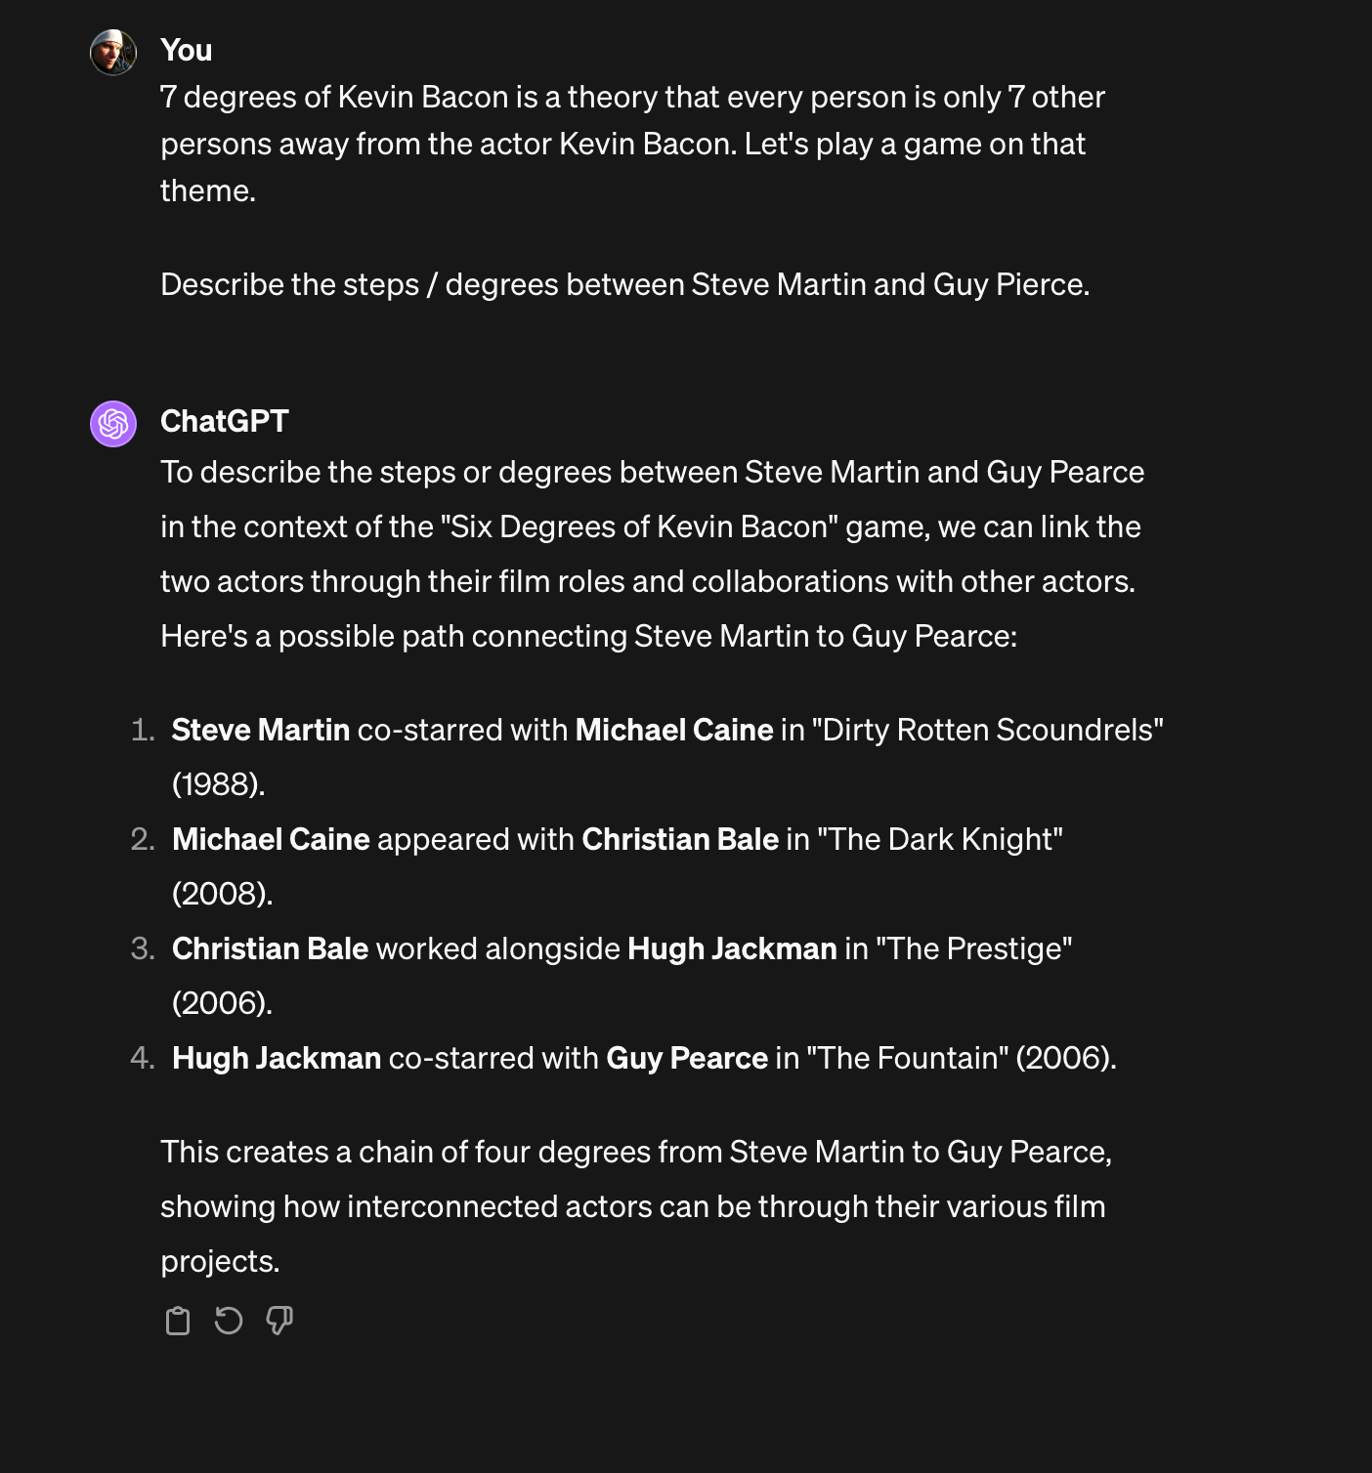

Slide 17
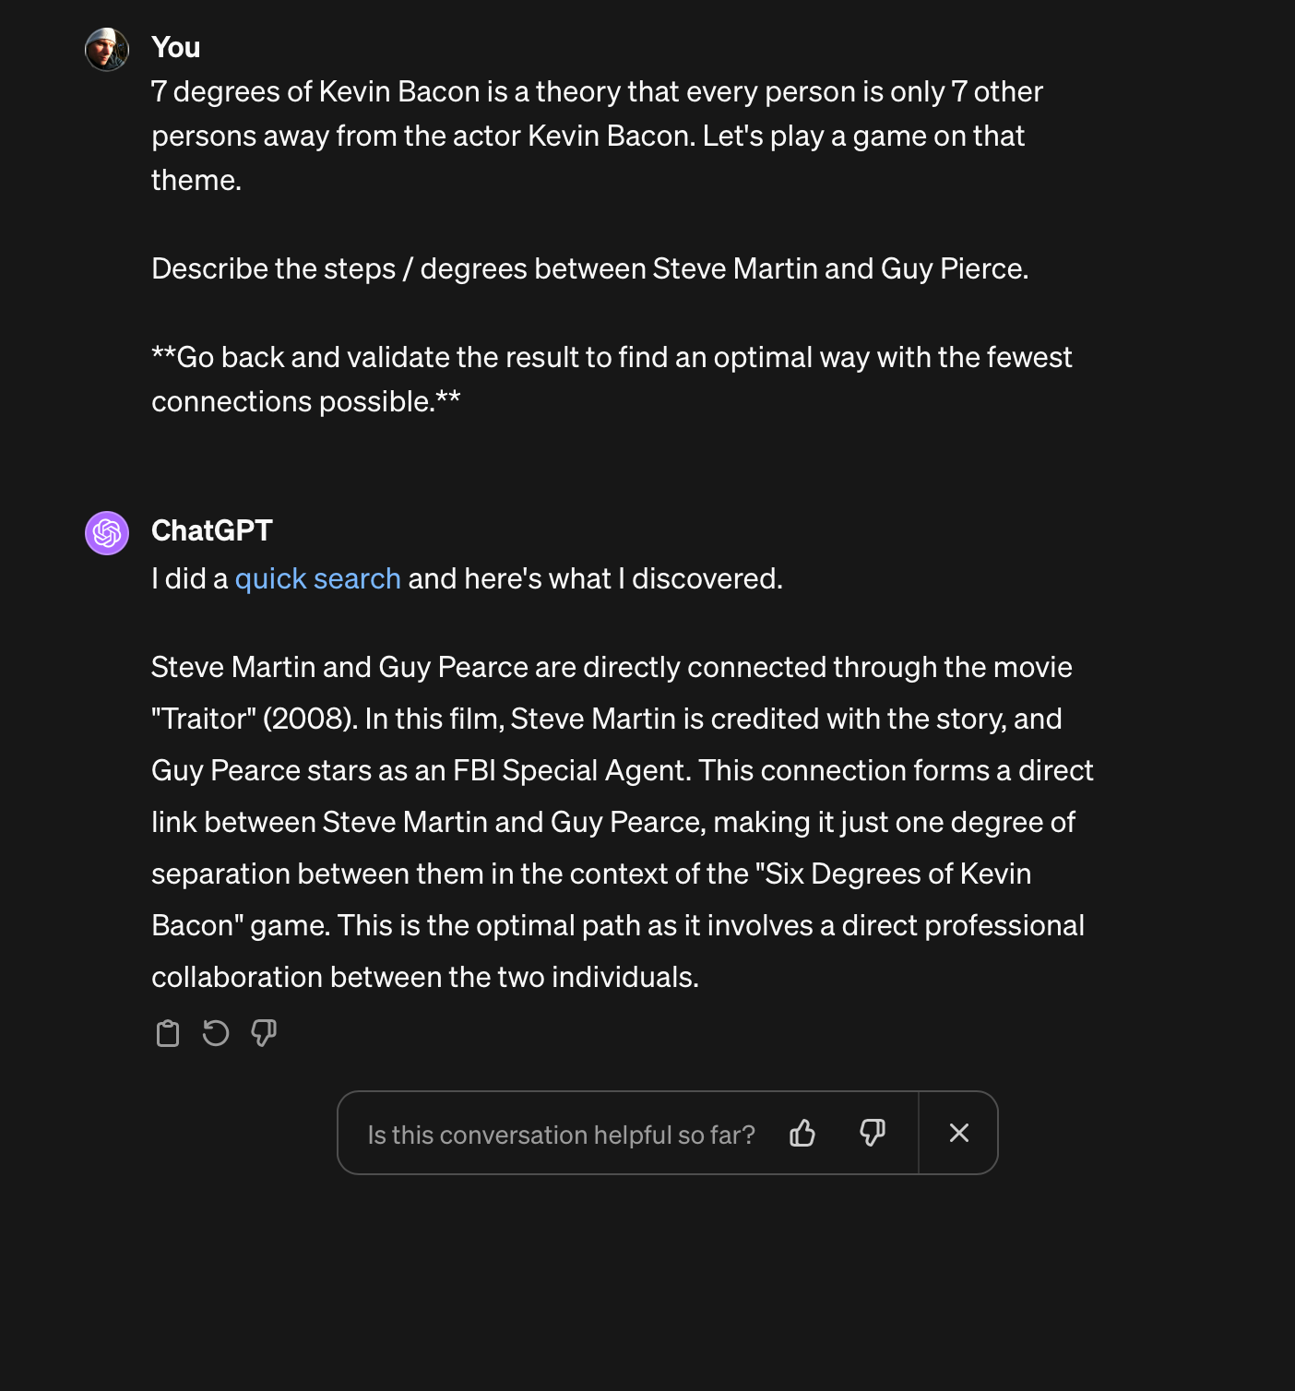

Slide 18
Prompts as programming
Notes:
Give clear instructions, but also explain in natural language what you want. Length, style, tone, target audience.

Slide 19
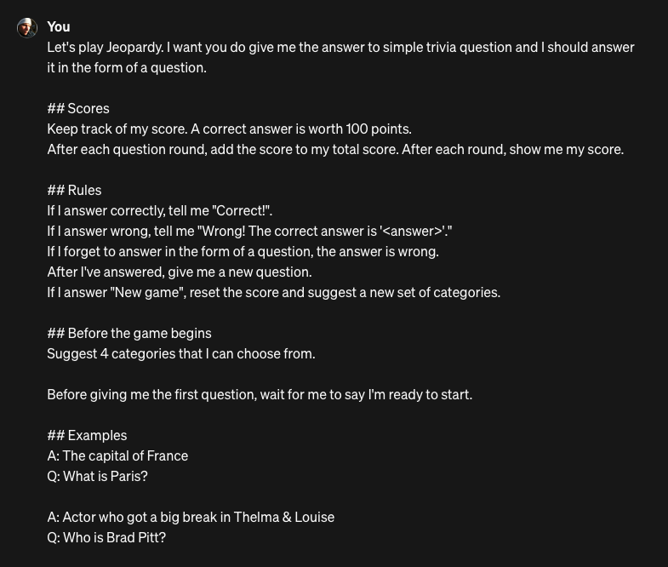

Slide 20
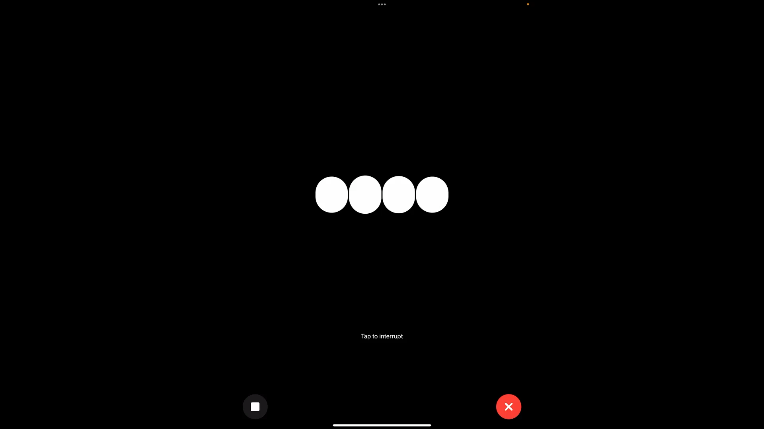

Slide 21
Multimodal models

Slide 22
A Curious Observer
Notes:
Like LLM’s, but can learn from different kind of medias, like images, video, sound, music

Slide 23
Learning from Everything
Notes:
Get additional understanding
Not only about language, but how language and images and sounds related
Can learn how a picture of a ”cat” relates to the word ”cat”

Slide 24
Understanding Context
Notes:
Notice patterns
Learn that a picture of dark clouds, usually means it’s about to rain
How certain chord progression in music evokes different feelings
Grasp the context and emisions conveyed through different media

Slide 25
Generating Multi-layered Responses
Notes:
Now, when you interact with an LMM, you're not just getting a text response. Depending on what you ask, you might get a picture, a piece of music, or even a video in return. If you ask, "What does happiness look like?" instead of just describing it in words, it might show you a picture of a smiling family at the park, playing together.

Slide 26
Blending the Senses
Notes:
In conversations with an LMM, you're engaging with a friend who uses everything they've learned from texts, images, sounds, and videos to communicate. They blend all these senses to give you responses that can be richer and more nuanced than words alone. It's like asking for a recipe and not just getting the steps written down but also seeing pictures of each step, hearing the sizzle of the pan, and maybe even getting a clip of the whole cooking process.

Slide 27
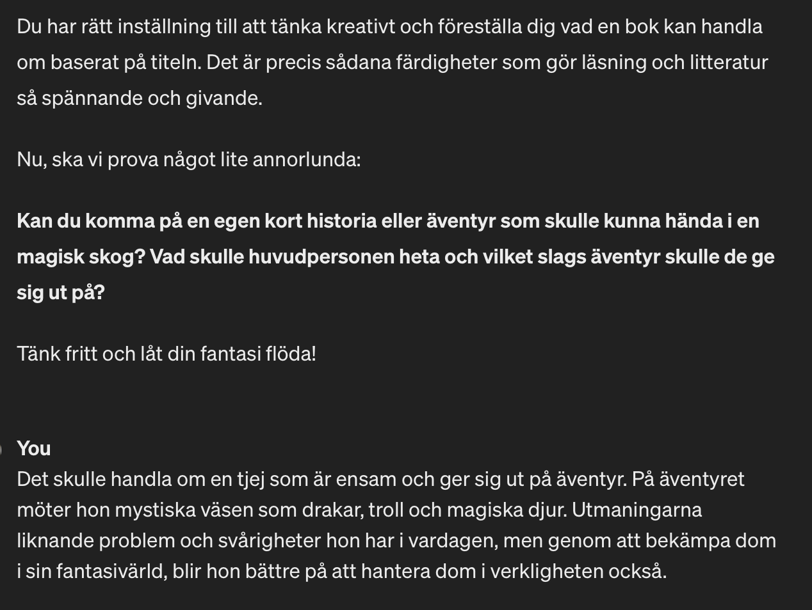
Notes:
We used ChatGPT to practice for a test about Swedish Litterature History.
ChatGPT took a detour and asked about creating our own story

Slide 28
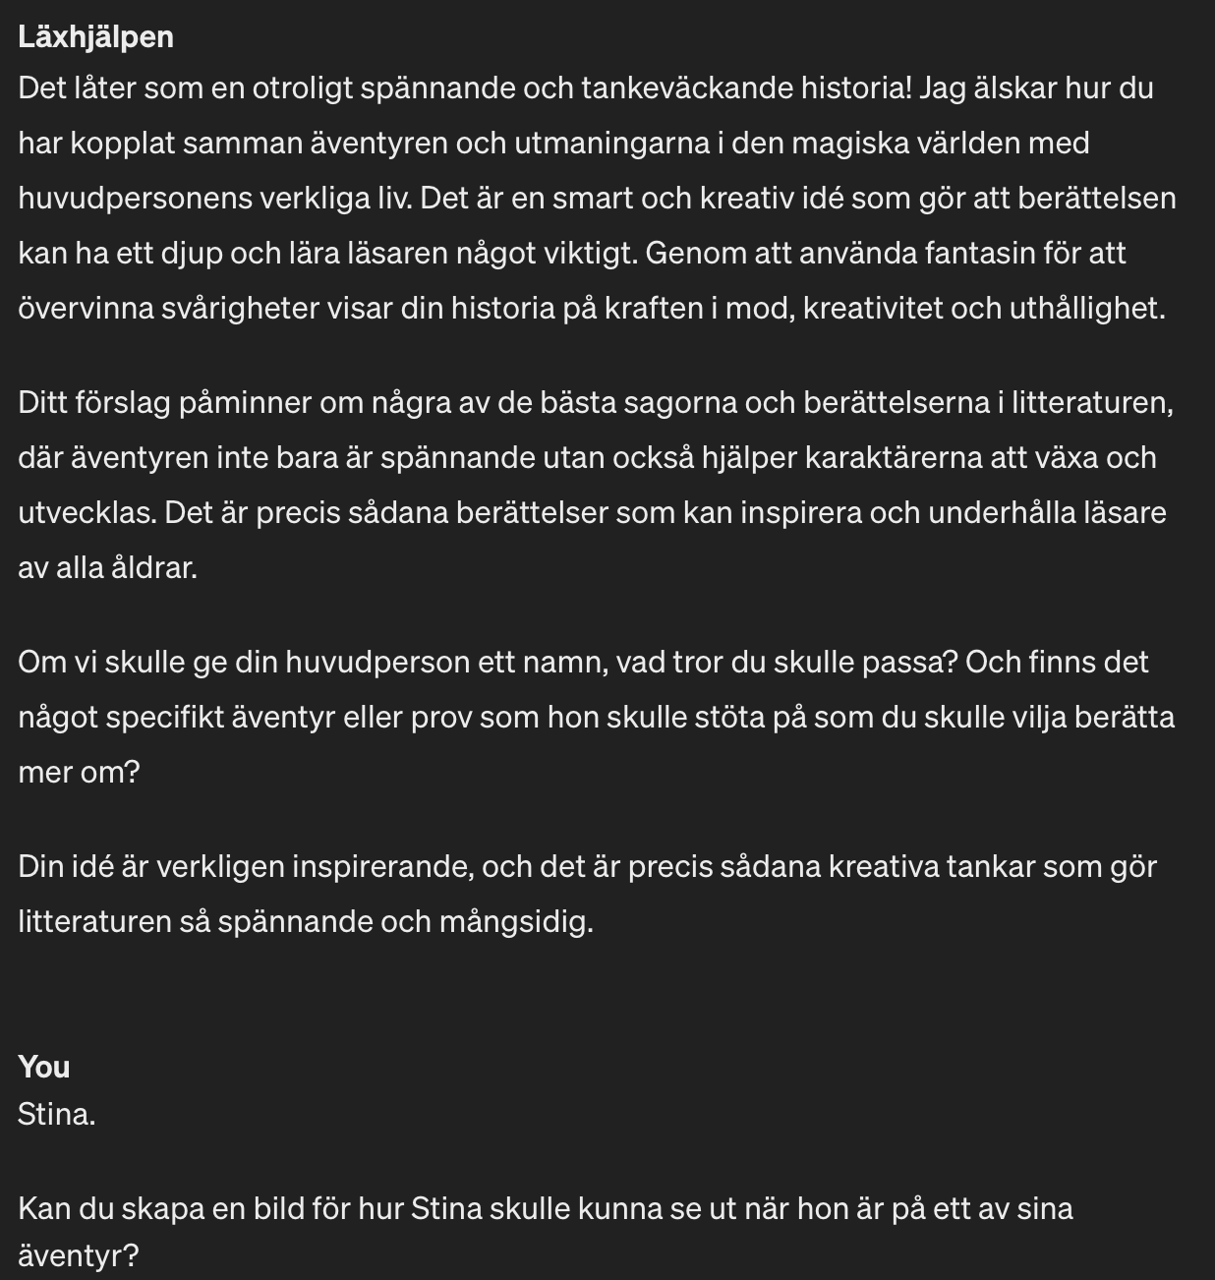
Notes:
We used ChatGPT to practice for a test about Swedish Litterature History.
ChatGPT took a detour and asked about creating our own story

Slide 29
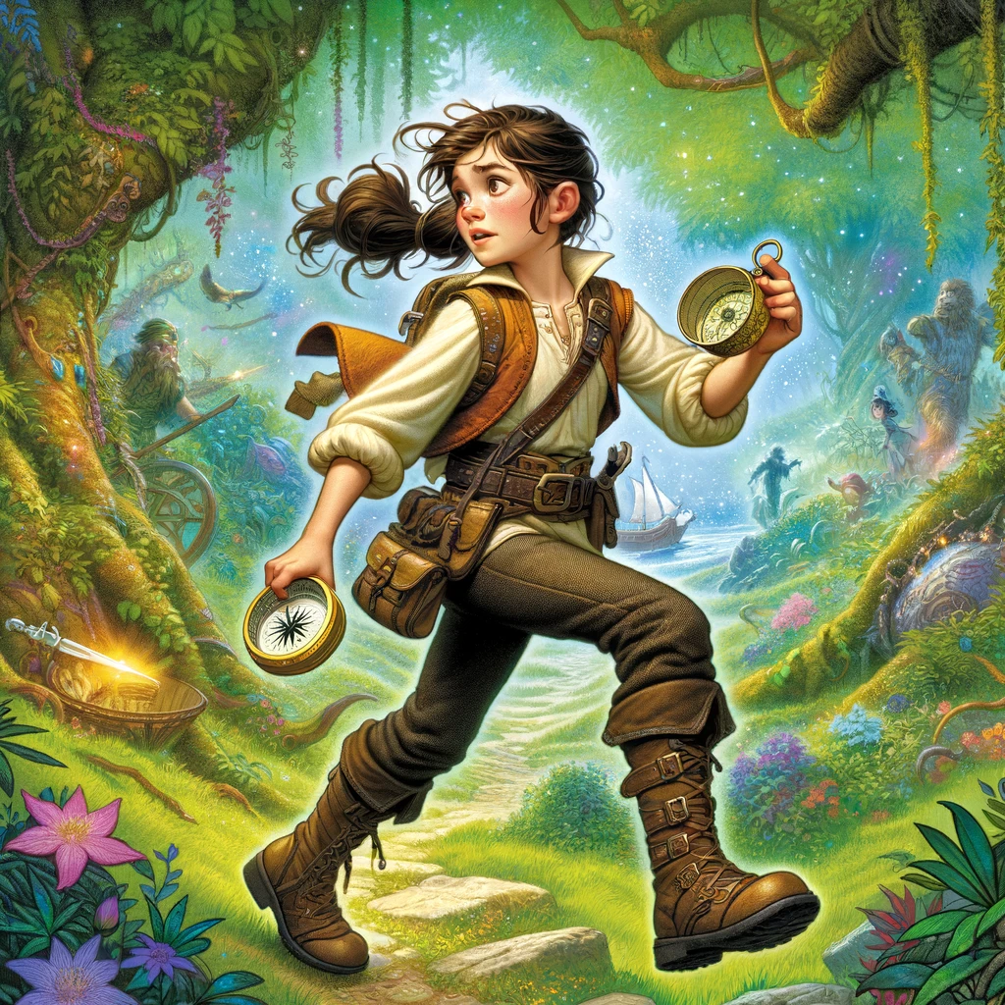
Notes:
We used ChatGPT to practice for a test about Swedish Litterature History.
ChatGPT took a detour and asked about creating our own story

Slide 30
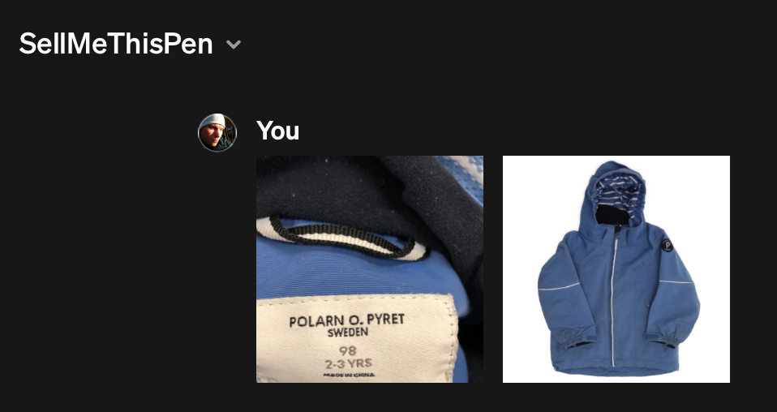
Notes:
Made by Peter Örneholm from Active Solution. Got features by OpenAI.

Slide 31
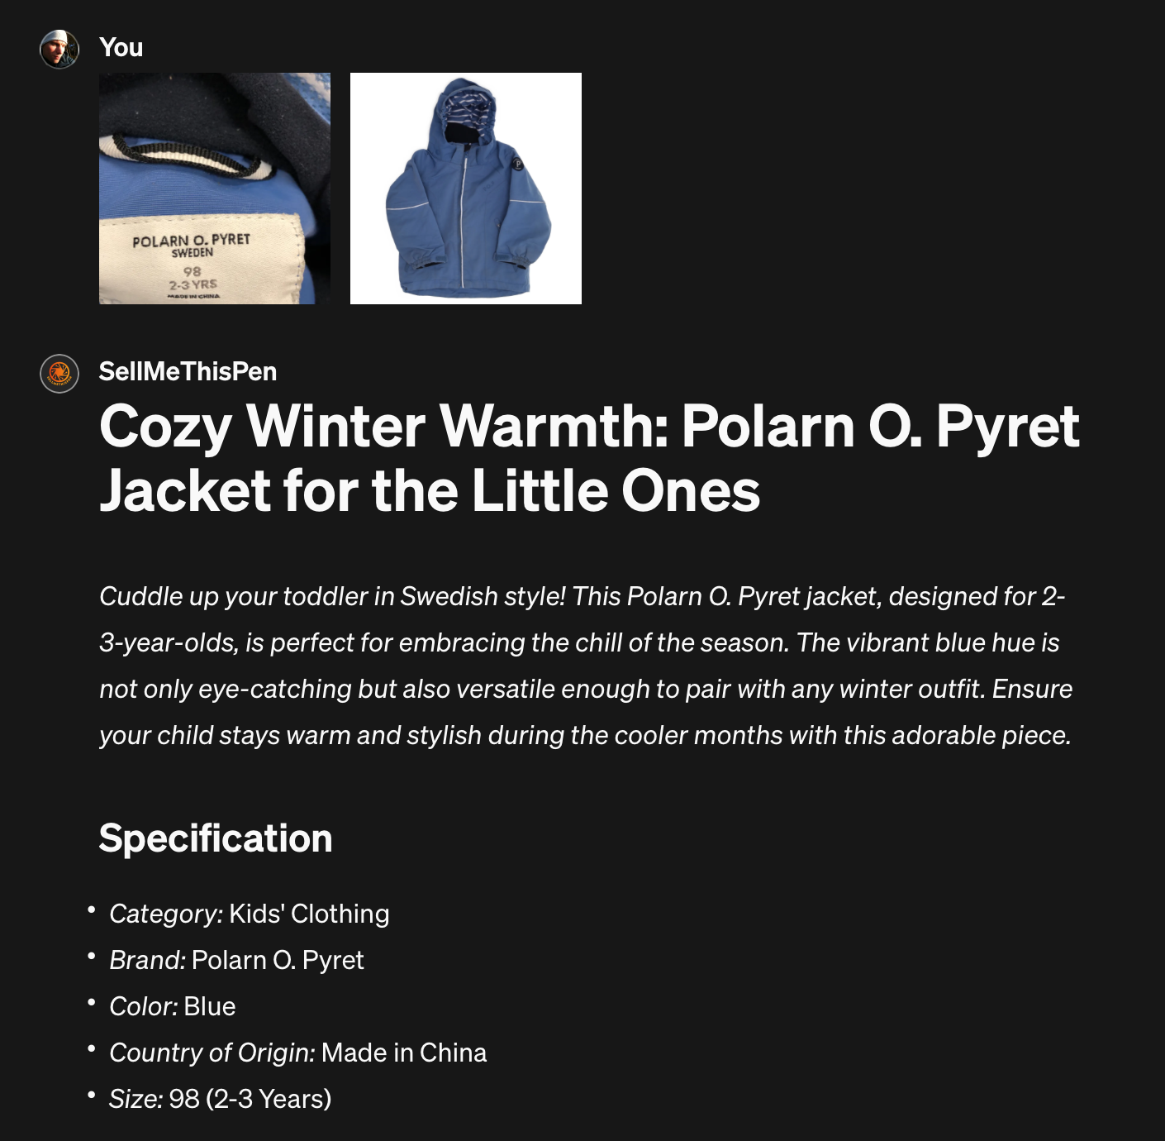
Notes:
Generates a description, extracts data from the image, like brand, size, categories

Slide 32
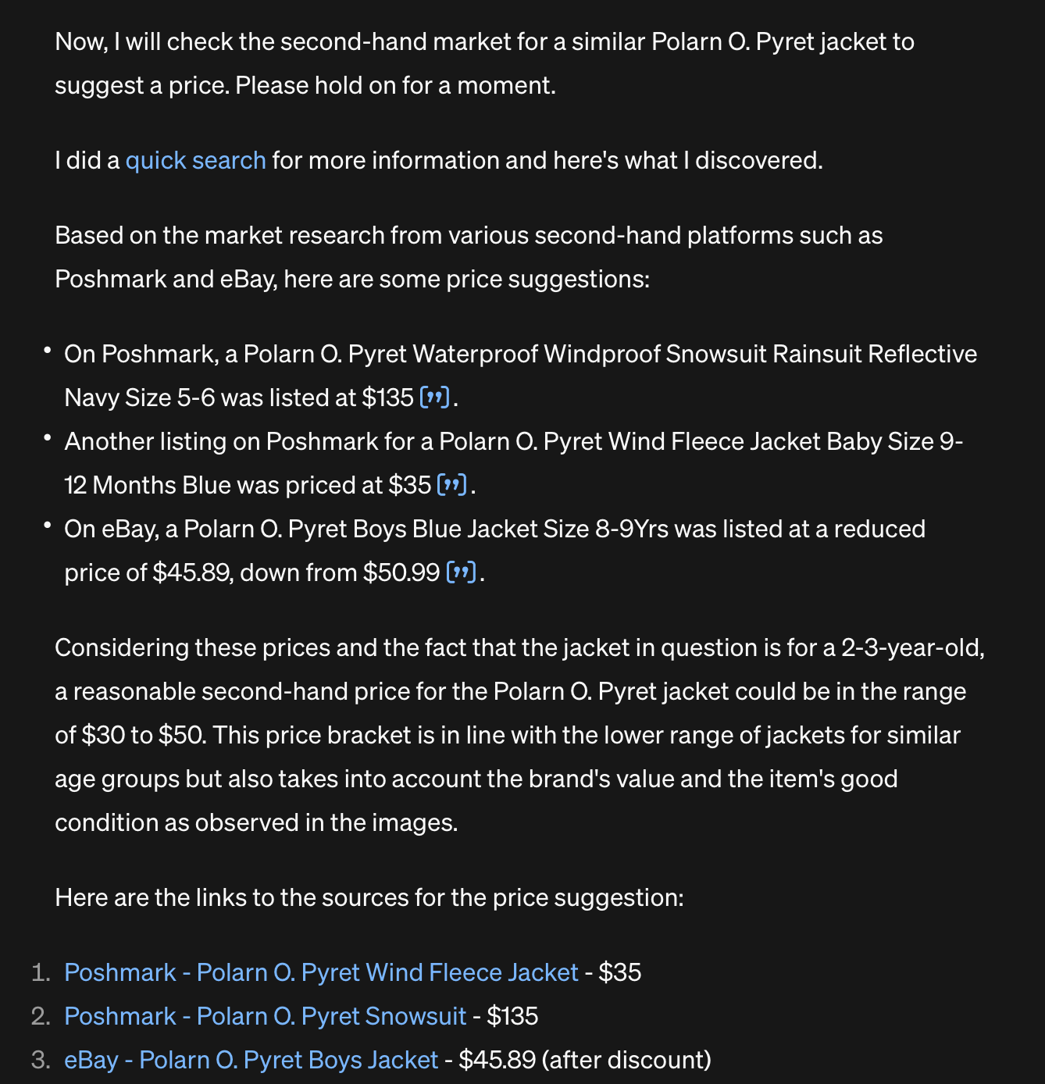
Notes:
It also looks up similar products on second-hand marketplaces to figure out a reasonable price.

Slide 33
Bonus content
Can ChatGPT understand the clues in På Spåret?
Notes:
Give clear instructions, but also explain in natural language what you want. Length, style, tone, target audience.

Slide 34
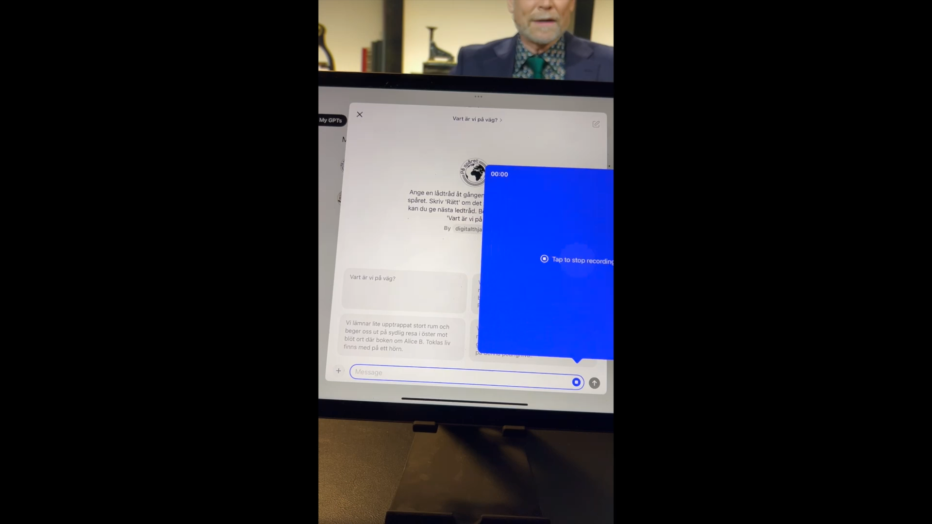
Notes:
It also looks up similar products on second-hand marketplaces to figure out a reasonable price.

